Slide 1


Extending the work of team "Farzi Data Scientists"
Toward a Modular, Real-Time, Energy-Efficient RAN Optimization Framework
Duration: 4 Months

Slide 2
Understanding Farzi's Project
Aim: To predict the energy consumption of 5G base stations using real-world configuration and traffic data.
Method:
Collected hourly BS data (load, TX power, ES modes, etc.)
Applied feature engineering: time lags, signal processing, spline features
Trained ANN models (FastAI and Keras)
Used SHAP for post-hoc model explainability
Output:
Offline CSV predictions of BS energy consumption
Achieved high accuracy on ITU-Zindi leaderboard
Demonstrated generalisation across base station configurations

Slide 3





Strengths of Farzi’s Work
Accurate ANN-based prediction of energy usage
Strong domain-informed feature engineering
Differentiated analysis for existing vs. new BSs
Effective use of SHAP to explain feature importance
Generalisable to unseen BS setups
Clean Kaggle-based reproducible implementation

Slide 4
Gaps Identified in Farzi’s Work
We identified the following gaps that limit real-world deployment:
1
No system-level orchestration
2
No optimization layer for energy-efficient configurations
3
No feedback loop for outcome validation
4
No actuation (i.e., BS config change application)
5
No decision-level explainability (only model-level)
6
No QoS vs. energy trade-off control
7
No simulation-in-the-loop testing
8
No coordination across multiple BSs
9
No policy-based decision-making framework
10
Not designed for rural/edge environments
11
No fallback or self-healing logic
12
No operator-facing dashboard

Slide 5

Our Use Case – Auto EA-SORAN
Title: Autonomous Energy-Aware Self-Optimizing RAN
Goal: Extend Farzi's model into a real-time, modular, closed-loop orchestration system for BS energy optimization.
Key Features:
Enhances Farzi's ANN prediction inside an orchestration loop
Adds optimizer to suggest best config (Tx power, BW, ES modes)
Integrates NS-3 simulation before application
Applies configs via orchestrator agent
Monitors outcomes with rollback fallback
Generates human-readable explanations for each action
No operator input needed (autonomous, policy-driven)

Slide 6














Proposed System Architecture
Modular Multi-Agent Design:
Prediction Agent
Monitor Agent
uses enhanced ANN model
collects BS metrics in real-time
Optimizer Agent
Static Policy Handler
selects best BS config
YAML/config-based goals
Orchestrator Agent
simulates + applies config
Explainability Layer
Feedback Agent
SHAP + reasoning trace
validates outcomes + triggers rollback
Built using ZeroMQ. Lightweight and edge-deployable.

Slide 7
Addressing the Gaps
1
No system-level orchestration
Solution:- Implement a modular multi-agent orchestration loop (Monitor → Predict → Optimize → Orchestrate → Feedback).
2
No optimization layer for energy-efficient configurations
Solution:- Develop a multi-objective Optimizer Agent to recommend BS settings balancing energy savings and performance.
3
No feedback loop for outcome validation
Solution:- Introduce a Feedback Agent that monitors KPIs and validates the impact of each configuration decision.
4
No actuation (i.e., BS config change application)
Solution:- Use NS-3/Simu5G simulations or mock API endpoints to safely apply the chosen configuration to the base station in a testbed.
5
No decision-level explainability (only model-level)
Solution:- Add SHAP + rule-based action explainability to justify every configuration change, making decisions human-interpretable.
6
No QoS vs. energy trade-off control
Solution:- Embed QoS constraints into the optimization logic to prevent degradation of network quality while saving energy.
7
No simulation-in-the-loop testing
Solution:- Integrate NS-3 or Simu5G to simulate BS configuration changes before live application to validate safety and effectiveness.
8
No coordination across multiple BSs
Solution:- Extend architecture for multi-BS awareness, allowing dynamic offloading and coordination among base stations.
9
No policy-based decision-making framework
Solution:- Implement a static policy handler using YAML or JSON config files to encode energy-saving preferences and operating rules.
10
Not designed for rural/edge environments
Solution:- Use lightweight agents (Python + ZeroMQ) that can run on edge hardware with minimal computational requirements.
11
No fallback or self-healing logic
Solution:- Build in rollback and recovery capabilities triggered by the Feedback Agent if a new config leads to performance degradation.
12
No operator-facing dashboard
Solution:- Develop a simple, visual dashboard using Streamlit/Grafana or Flask to show BS state, energy saved, decisions made, and justifications.

Slide 8
What Makes Auto EA-SORAN Unique?
Transforms prediction into autonomous energy optimisation
Built-in action-level explainability (beyond model SHAP)
First-of-its-kind system integrating:
Designed for edge and rural telecom infrastructure
Prediction + Optimisation + Simulation + Action + Feedback
Fully autonomous (no intent engine or operator needed)
Ready for ITU FG-AINN WG3/WG4 alignment and PoC showcase

Slide 9
Expected Outcomes
By the end of the 4-month phase, we aim to deliver:
Working prototype of Auto EA-SORAN
Simulation-based evidence of BS energy savings
Config change orchestration based on policies
Dashboard showing energy-QoS trade-offs
SHAP + reasoning explanations for each config decision
Documented PoC system for further R&D and ITU submission

Slide 10
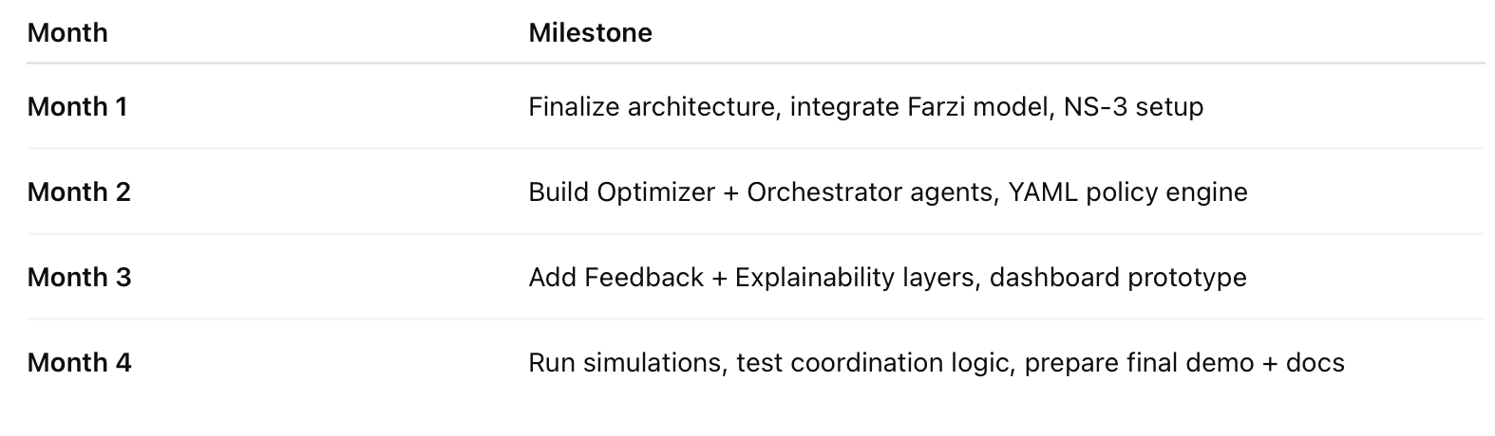
Timeline of the project

